Slide 1
Parameter Capturing in NX Custom Reporting

Slide 2
Overview
Filtering conditions in NX Custom reports can be used in calculated columns
Calculated columns can be used to create spaces for custom user inputs to reports
Custom inputs can greatly increase the flexibility and speed of custom reports

Slide 3
1. Capturing an input parameter

Slide 4
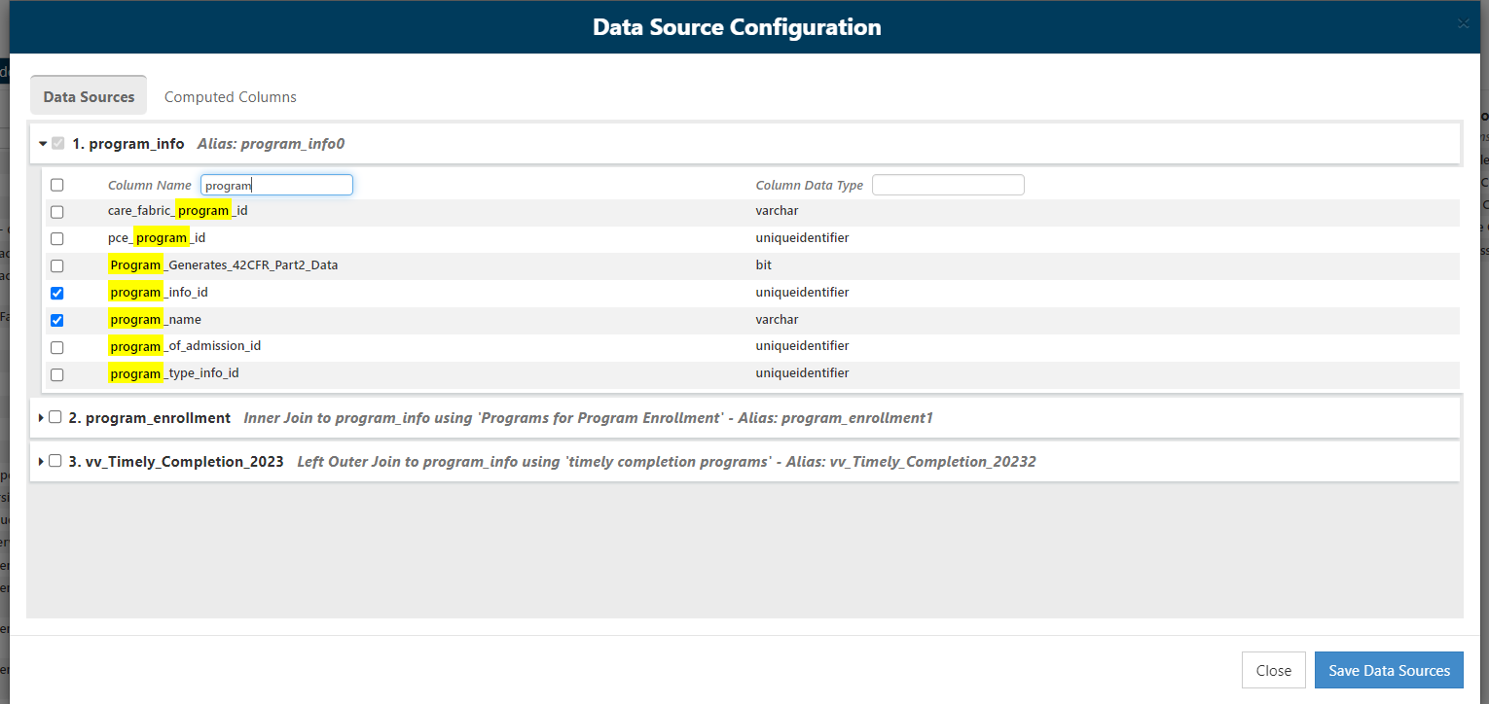
For this example, we will make a new custom report based on the program_info table. The program_info_id and program_name columns will be used in the report.

Slide 5
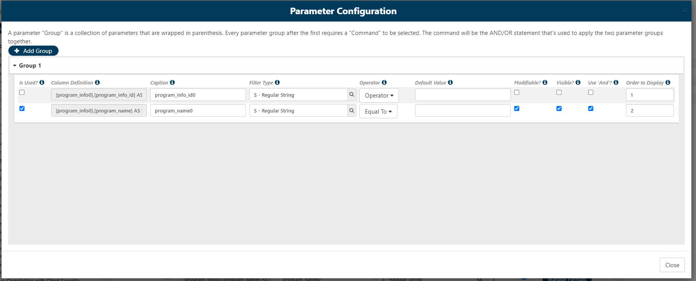
Normally, if we wanted to filter the results by program_name, we would open the Manage Parameters menu and specify program_name like this.

Slide 6
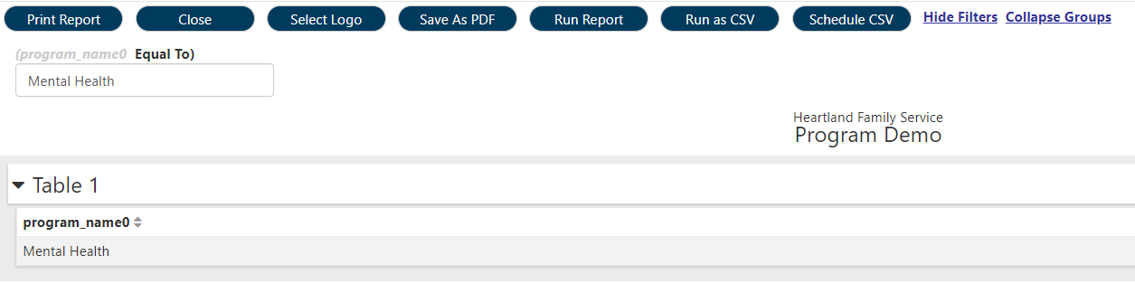
When launching the report, specifying Mental Health in the input box gives us the result where program_name = 'Mental Health'

Slide 7
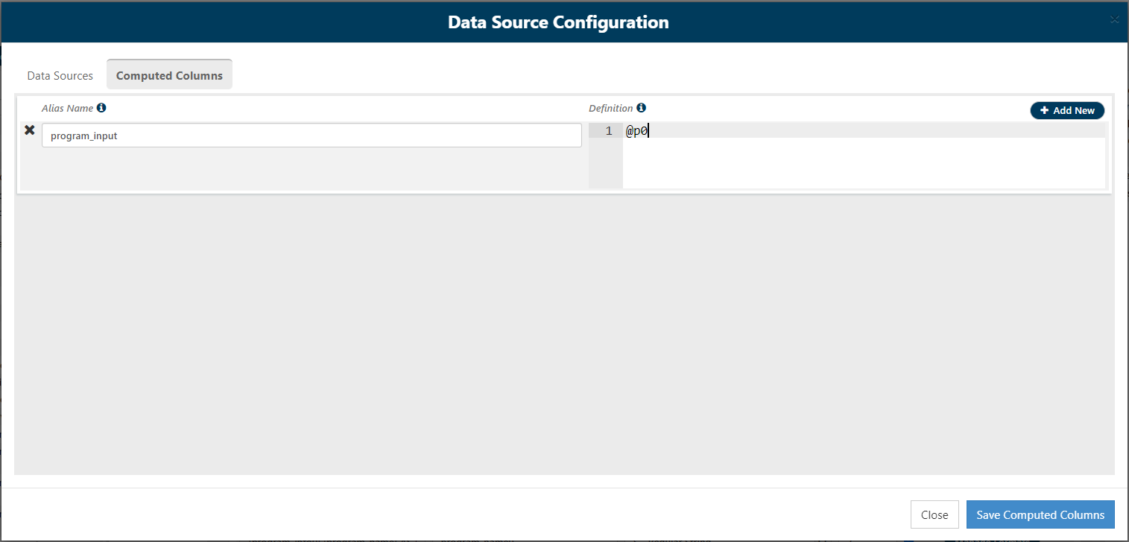
The Custom Reporting engine uses inputs by automatically creating parameters for each input field. Parameters are indicated with an @ prefix and are numbered from @p0 to @p1 and so on.
Once created by selections under Manage Parameters, calculated columns can reference parameters.

Slide 8
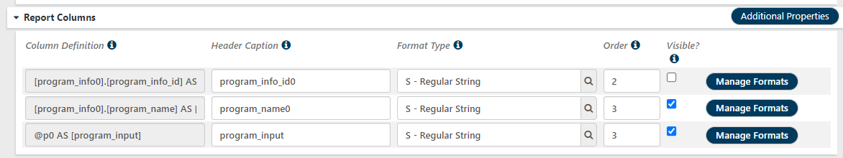
Calculated columns based on input parameters can be displayed in Tables. In the simplest usage, we can capture an input and show what the user put into the input fields when running the report.

Slide 9
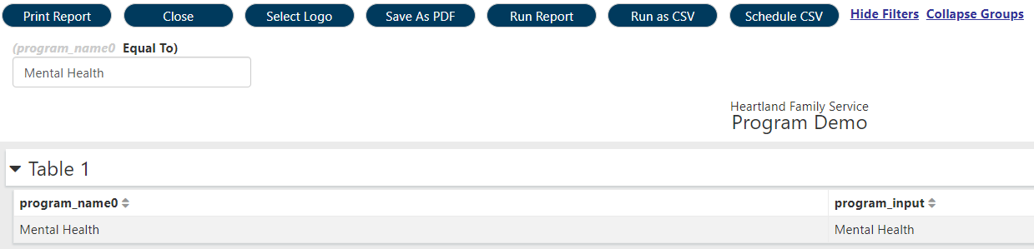
The input field at the top filtered the result set to the row(s) for Mental Health. The program_input column restates what the user put into the input control.

Slide 10
2. Creating custom inputs

Slide 11
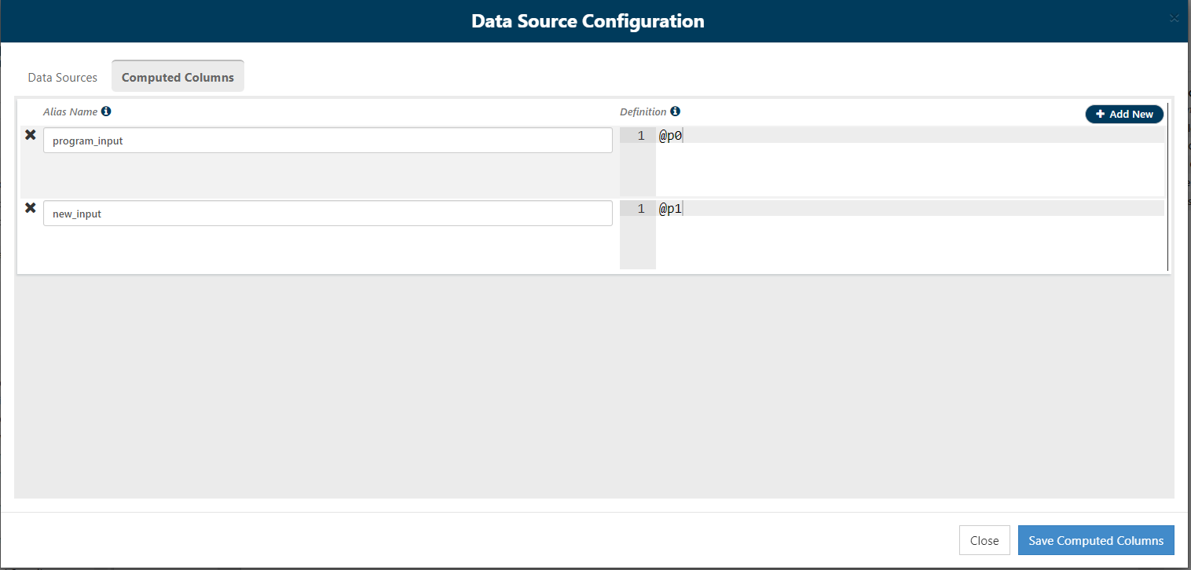
The new_input calculated column is defined first. At the moment, there is not a @p1 parameter, but we will have one before we run the report.

Slide 12
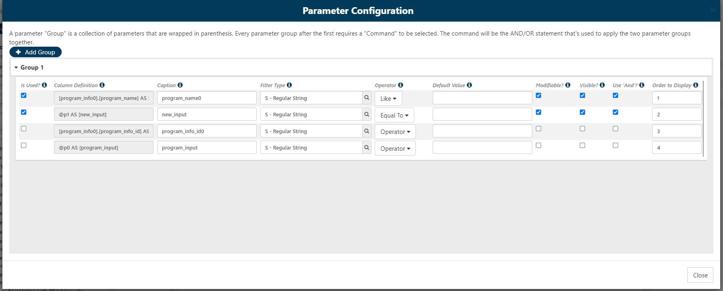
Under Manage Parameters, we mark the new_input field as used for filtering. Filter type should follow the type of input we want to take (string, date, number, Boolean, etc.). We will make the input visible and modifiable so we can put a value in the field next.

Slide 13
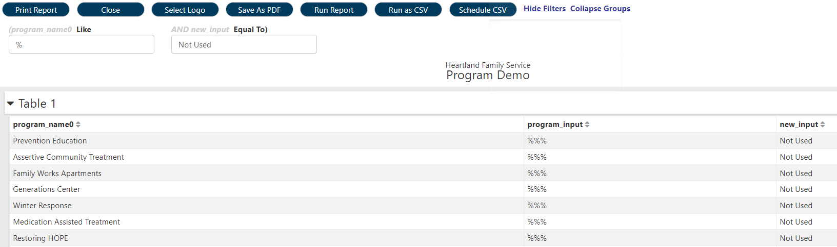
Searching for program_name like '%' gives us all programs. At the moment, the new_input is not used for filtering, but the contents are visible in the results table.

Slide 14
3. Filtering based on a custom input

Slide 15
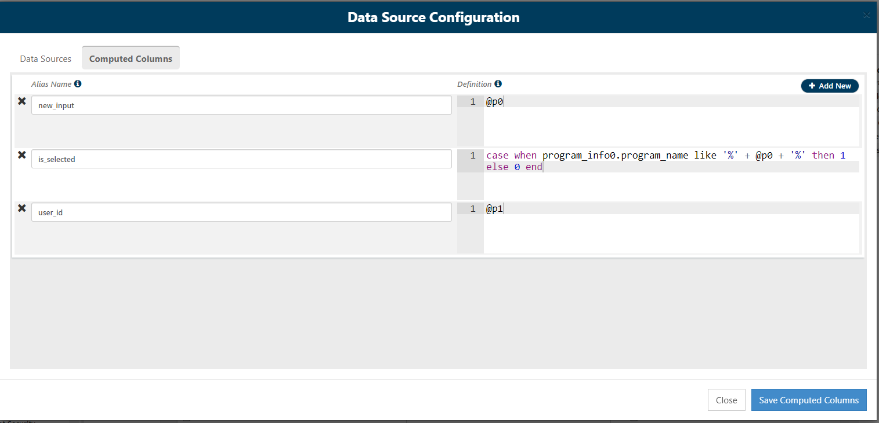
To filter based on an input parameter, we can make a new calculated column based on the input. The easiest method is to calculate a 1 if the record should be included in the result, and a 0 otherwise.

Slide 16

Note that we need to create an input space for the custom parameter first, then reference it in another calculated column. Also note that the calculated column must not include line breaks in order to be used for filtering.

Slide 17
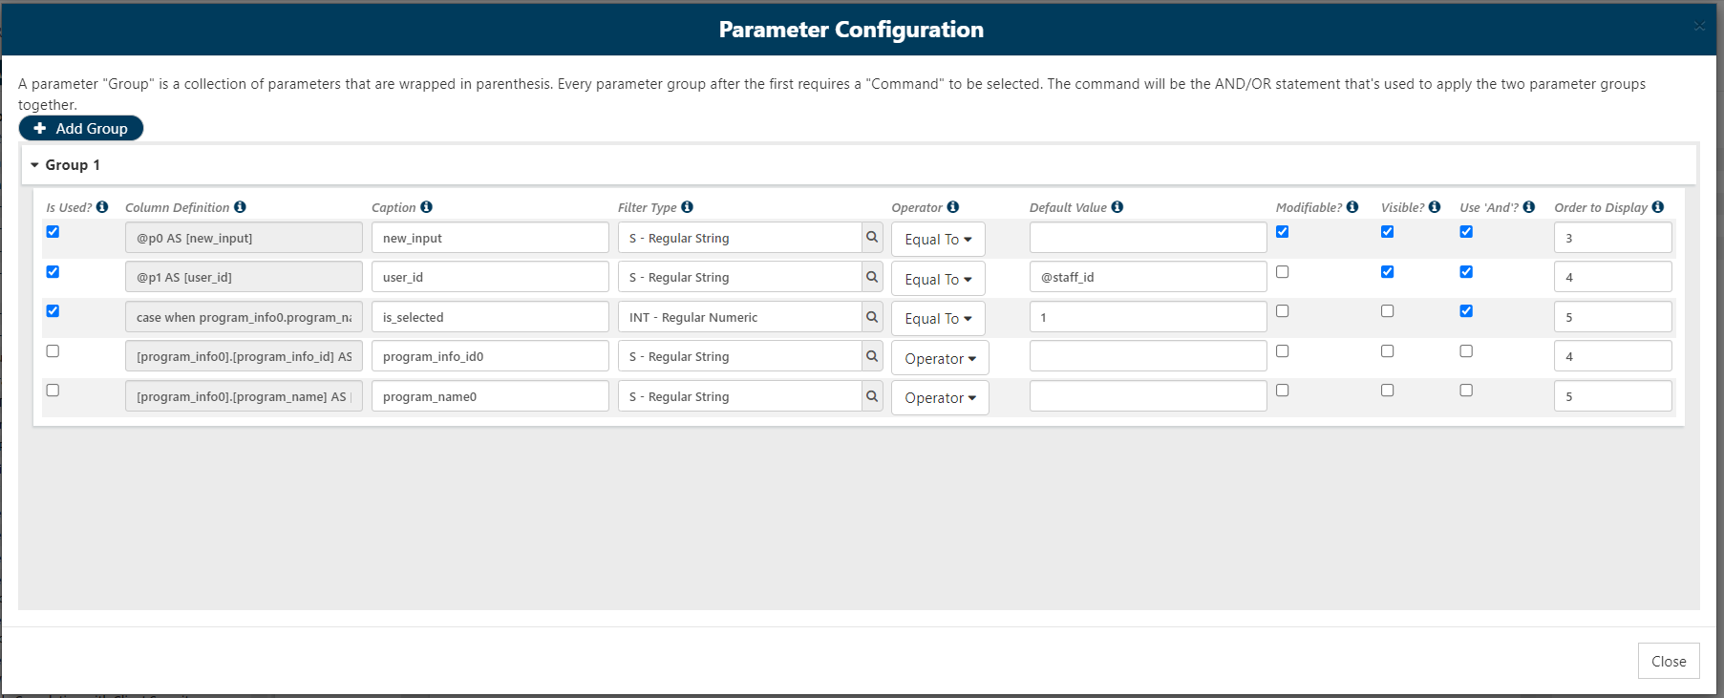
Under Manage Parameters, we now filter the results based on the result of our new is_selected column. Any row with a 1 will be included in the result. The current user is a pre-defined parameter, but is only available in this menu. To reference the current user, we need to make a new input space for the staff_id, then define the default value under Manage Parameters like this.

Slide 18
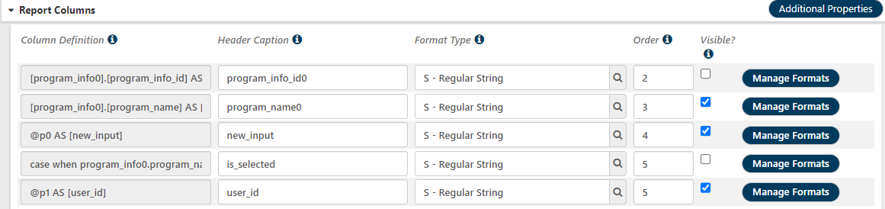
These new parameters do not have to be visible in the report to be used for filtering.

Slide 19
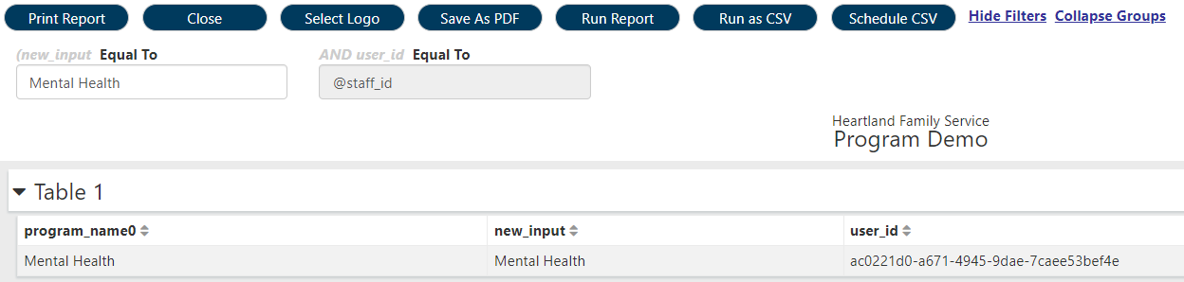
Now the report will filter results according to our custom input parameter. Also note that we can capture the staff_id of the user who ran the report.

Slide 20
4. Subqueries based on an input

Slide 21
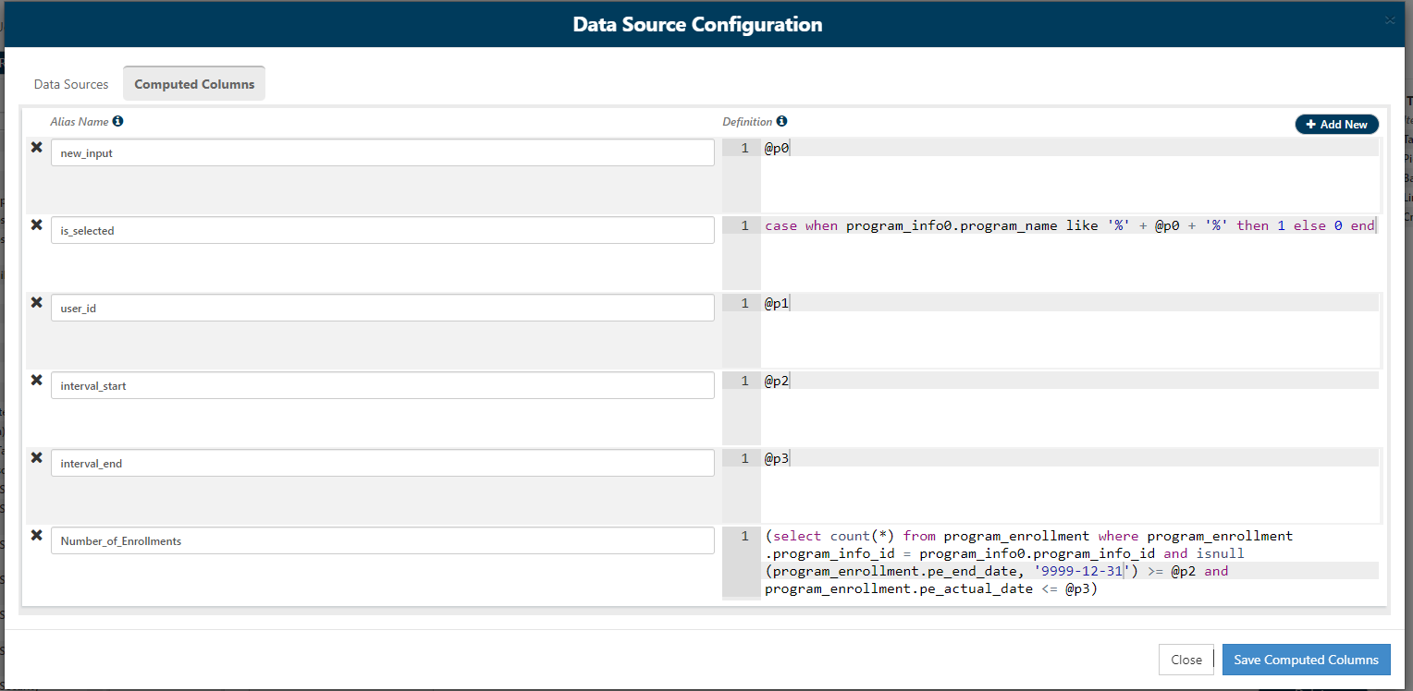
Here we added two new parameters, defining the start and end of a time interval. We then use those parameters in a subquery to count how many program enrollments overlapped that interval.

Slide 22
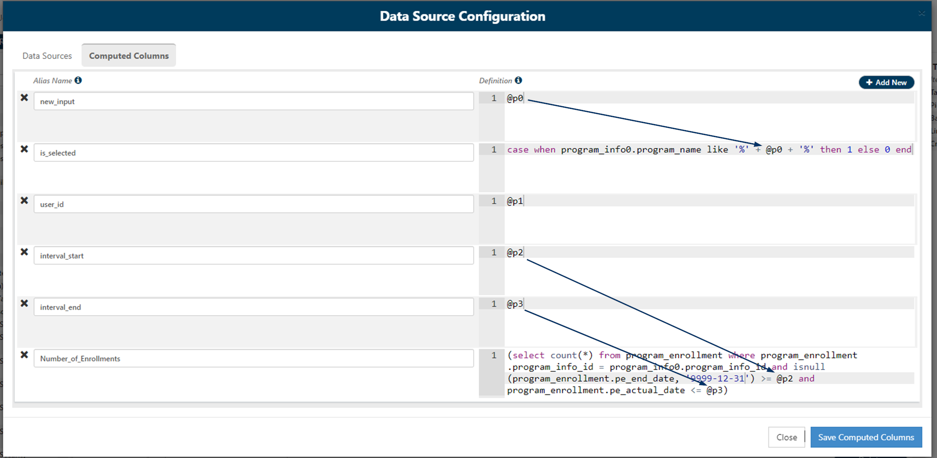
With this approach, we can generate counts of clients/enrollments/events that occurred over whatever period the user wants to see.

Slide 23
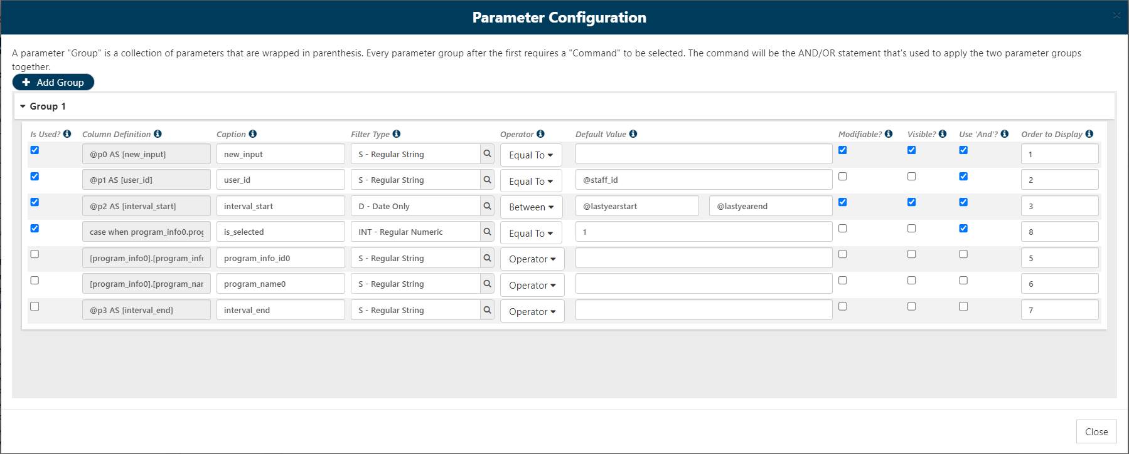
Using Between as the comparison operator actually generates two parameters, one for the start date and one for the end date. The subquery does not actually depend on the interval_start being between the start and end dates, but this does not matter because the real calculation happens inside the subquery.

Slide 24
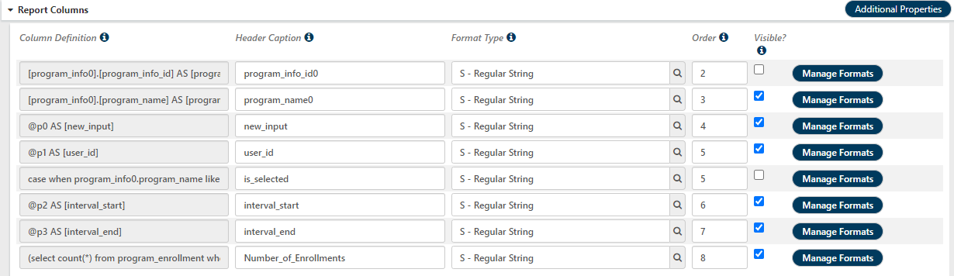

Slide 25
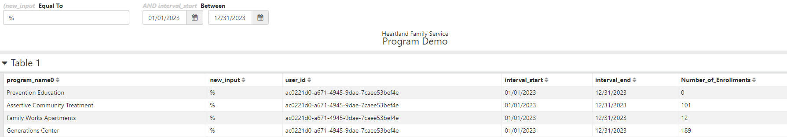
Running the report shows the count of active enrollments between January 1, 2023 and December 31, 2023. The user can specify a new date range and re-run this report as needed.

Slide 26
5. Calculations based on subqueries based on input

Slide 27
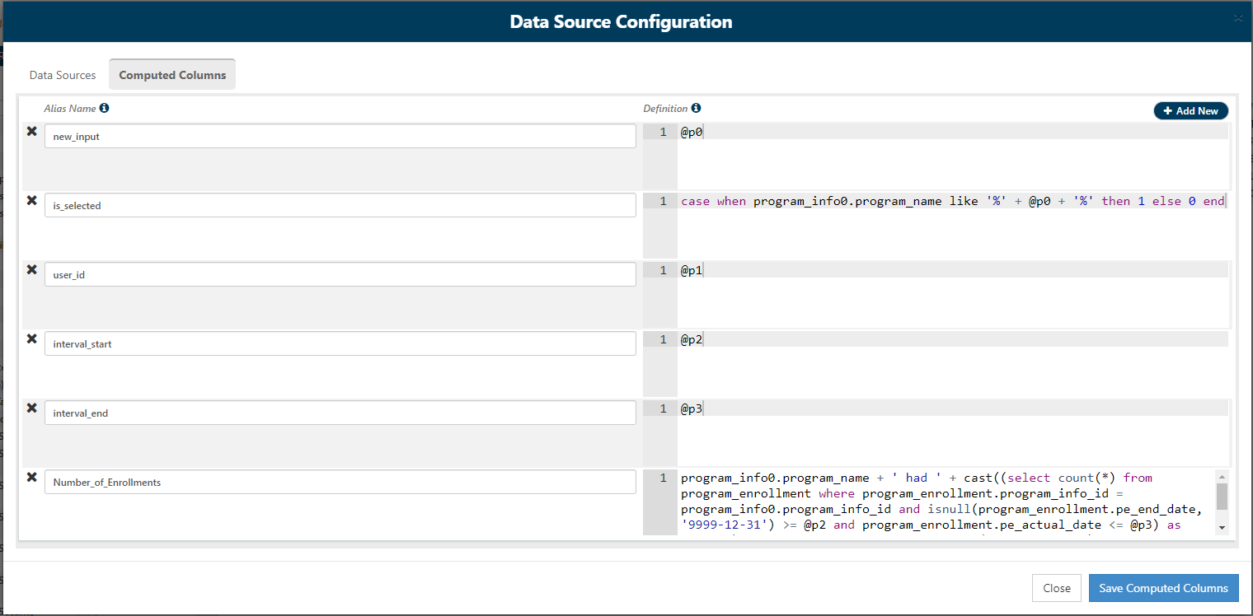
Here we modified the Number of Enrollments column to print out a sentence with the name of the program, the date range, and the count all included.

Slide 28
Summary of Enrollments over Time Period
program_info0.program_name + ' had ' + cast( ( select count(*) from program_enrollment where program_enrollment.program_info_id = program_info0.program_info_id and isnull(program_enrollment.pe_end_date, '9999-12-31') >= @p2 and program_enrollment.pe_actual_date <= @p3 ) as varchar ) + ' enrollments between ' + cast(@p2 as varchar) + ' and ' + cast(@p3 as varchar)
Remember to condense this definition into a single line if you want to use it in the Manage Parameters menu!

Slide 29
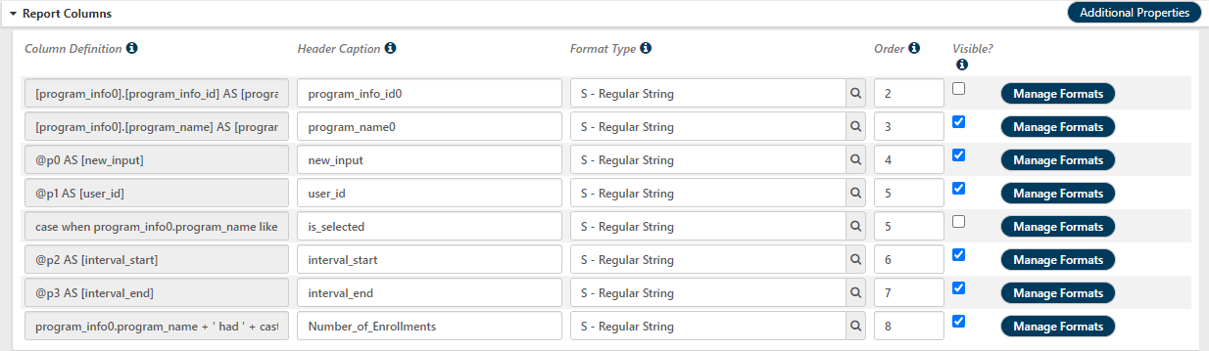

Slide 30
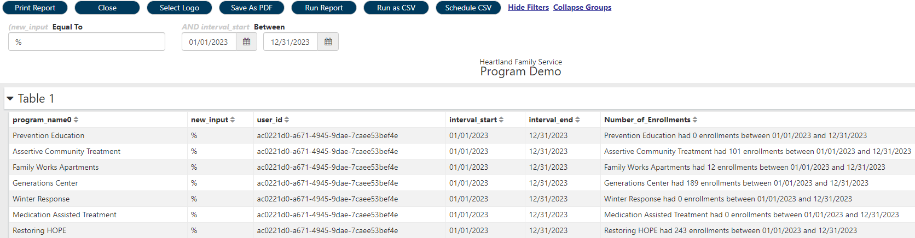
This approach combines the flexibility of choosing our own desired date range and inputs, while also showing what was requested to help validate the numbers returned.

Slide 31
6. Securing a Report

Slide 32
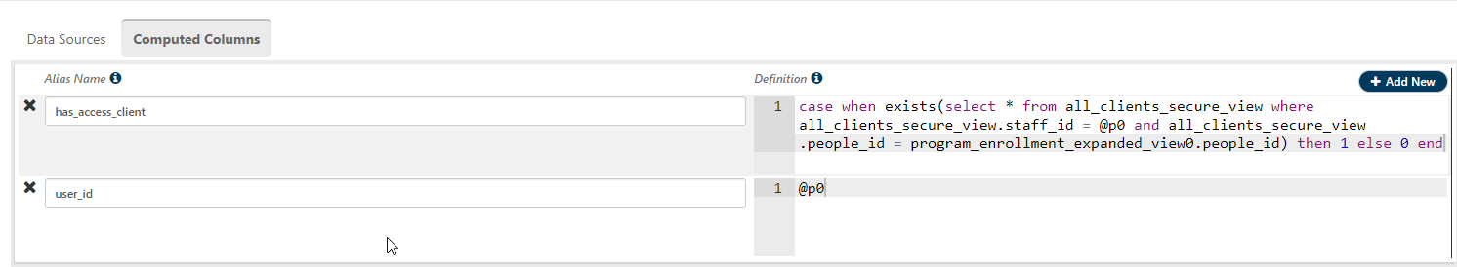
Compared to joining all_clients_secured_view to program_enrollment_expanded view and filtering the results by @staff_id, parameter capturing can return the same results almost twice as quickly.

Slide 33
8. Finding the last Follow-up before a deadline

Slide 34
The Query
Collects the first DLA-20 assessment per a program enrollment (first_event)
Collects all subsequent DLA-20 assessments for the same enrollment (second_event)
Assessments in same enrollment, but later dates
Finds the date of the next DLA-20 assessment after each second_event
Subquery to get minimum actual date for a DLA-20 in the same enrollment, taking place after second_event
Will be null if second_event is the last in the enrollment

Slide 35
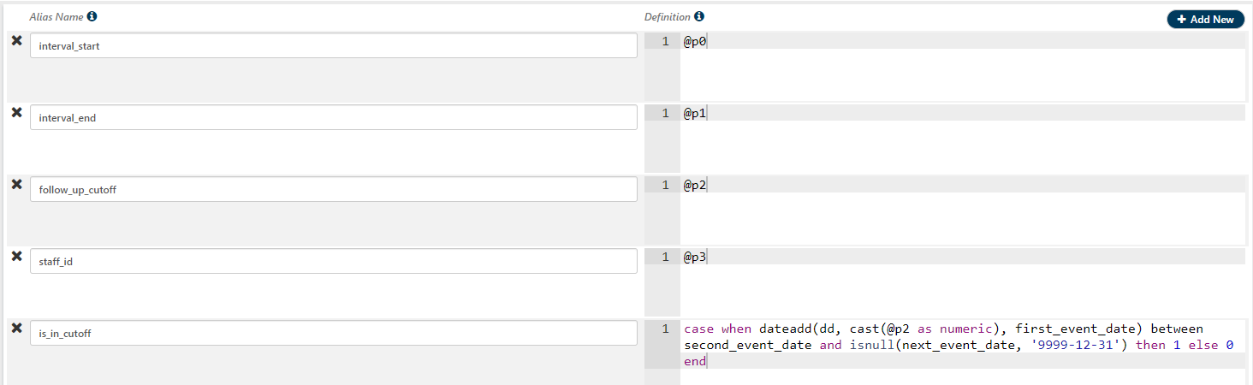
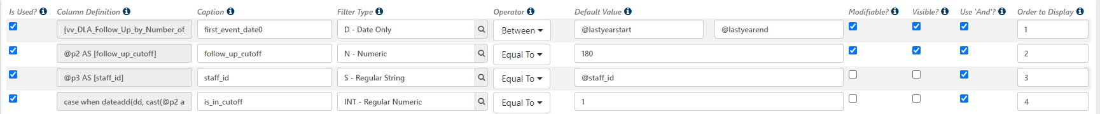
Is_in_cutoff calculates a deadline based on user input (using dateadd) then determines whether that deadline falls between any pair of follow-up event and next event. If yes, then this is the last record before the deadline, and this row is selected using the Parameters.

Slide 36
9. Advanced Text Search

Slide 37
Condensed Diagnosis List (at Time of Event)
SELECT
event_log.event_log_id,
STUFF(
(select distinct
', ' + replace(icd10_code, ' ', '')
from event_log as DXEL
inner join diagnosis_data on DXEL.event_log_id = diagnosis_data.event_log_id
inner join diagnoses on diagnosis_data.diagnoses_id = diagnoses.diagnoses_id
where DXEL.people_id = event_log.people_id
and isnull(DXEL.actual_date, '1753-01-01') <= isnull(event_log.end_date, '9999-12-31')
and isnull(DXEL.end_date, '9999-12-31') >= isnull(event_log.actual_date, '1753-01-01')
and dxel.event_definition_id = '526899D1-E158-41A0-BEE7-3AB814489ADB'
order by ', ' + replace(icd10_code, ' ', '') asc
FOR XML PATH('')
), 1, 2, '') AS current_diagnoses
FROM event_log
The resulting current_diagnoses column looks like "F10.20, F32.2, F43.10"

Slide 38
Dbo.fnSplit
Function that splits a delimited string into a table e.g., dbo.fnSplit('F10.20, F32.2, F43.10', ', ') yields:
We can then use this like another table in a (sub)query to check whether any current diagnosis for a client is LIKE some target string.
Item
F10.20
F32.2
F24.10

Slide 39
Dbo.fnSplit
select top 1 people_id
from udr.vv_Condensed_Diagnosis_List as dx,
dbo.fnSplit(replace(replace('F10|F20', '&', '%'), ' ', ''), '|')
where current_diagnoses like('%' + item + '%')
The comma in the FROM clause produces a Cartesian product (all possible combinations of rows). We then select just the rows where the current_diagnoses list contains the corresponding Item as a substring. We use replace to define a custom grammar: | means 'or' and & means 'and'
people_id | current_diagnoses | Item
1 | 'F10.20, F32.2, F43.10' | F10
1 | 'F10.20, F32.2, F43.10' | F20

Slide 40
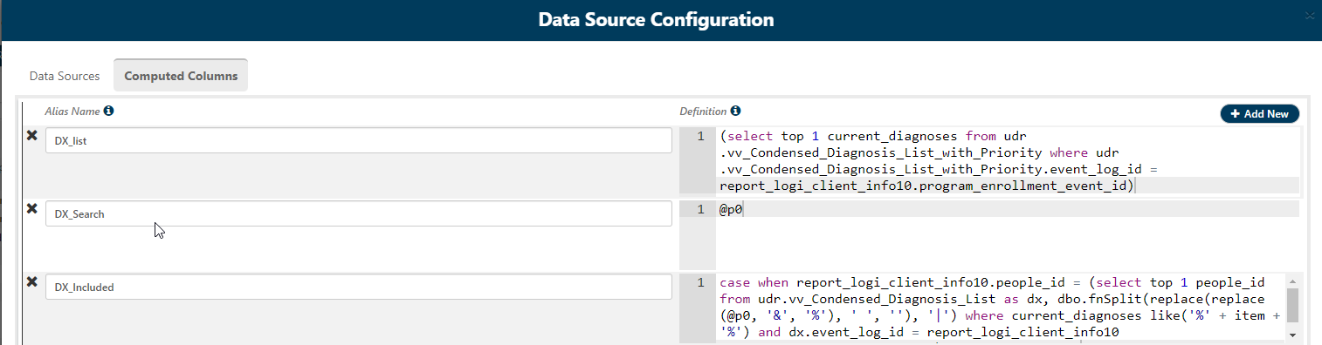

Slide 41
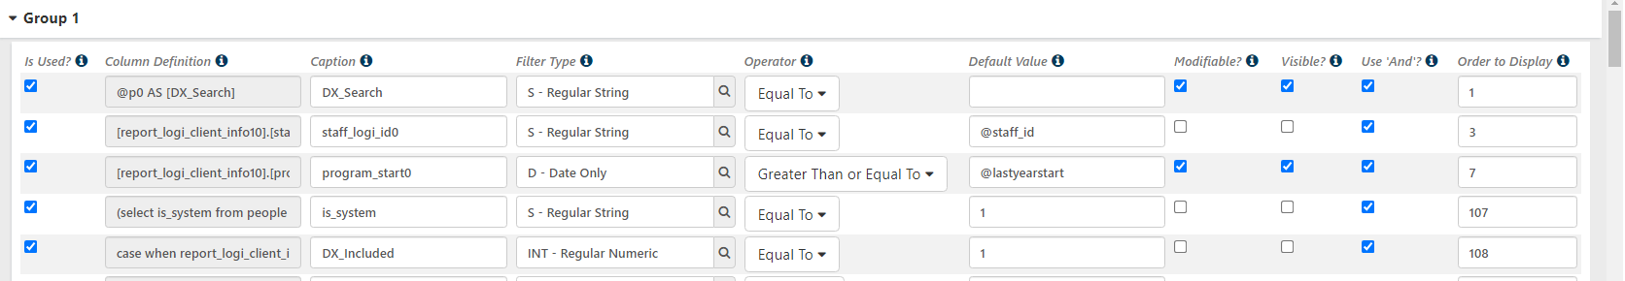

Slide 42
DX_Included
case
when report_logi_client_info10.people_id = (
select top 1
people_id
from udr.vv_Condensed_Diagnosis_List as dx,
dbo.fnSplit(replace(replace(@p0, '&', '%'), ' ', ''), '|')
where current_diagnoses like('%' + item + '%')
and dx.event_log_id = report_logi_client_info10.program_enrollment_event_id
) then 1
else 0
end
Remember to condense this definition into a single line if you want to use it in the Manage Parameters menu!

Slide 43
Example Search Strings
Partial Matches:
F – any Behavioral Health Diagnosis
F1 – any Substance Use Diagnosis
Ranges
F1[1-3]
F1[123] – both return diagnoses from F11 through F13
Alternative Diagnoses
F17|Z72 – Nicotine Dependence or Tobacco Use
Co-Occurring Diagnoses
F0&F1|F1&F[2-9] – Clients with both a non-Substance Use Behavioral Health Diagnosis and an SU Diagnosis

